Slide 1



JANUARY-MARCH 2019
SALES ANALYSIS REPORT
BRANCH A, B & C.
POWER BI PROJECT
GROUP A
OCTOBER 2025

Slide 2

INTRODUCTION
Our Journey
This project analyzes a supermarket sales dataset containing detailed information on customer transactions across multiple branches. The aim is to identify sales trends, understand customer purchasing behavior, and evaluate overall business performance. Using Power BI, the data was cleaned, transformed, and visualized through interactive dashboards. These dashboards highlight sales trends across branches, top-performing product lines, customer preferences, and payment patterns. The insights gained from this analysis provide a clear understanding of what drives revenue and customer satisfaction, supporting data-driven decision-making for future growth..

Slide 3

DESCRIPTION
This project analyzes a supermarket sales dataset containing detailed information on customer transactions across multiple branches.
The dataset captures detailed transaction information from January through March 2019, with 100 records representing customer purchases.
The aim is to identify sales trends, understand customer purchasing behavior, and evaluate overall business performance to support data-driven decision-making for future growth.

Slide 4
OBJECTIVES OF THE ANALYSIS
1. To analyze overall sales performance across different product categories, cities, and branches to identify key revenue drivers.
2. To evaluate customer distribution and purchasing behavior based on customer type, gender, and payment method.
3. To monitor monthly sales trends in order to identify peak and low-performing periods.
4. To assess product category performance by comparing total sales and average unit prices across cities.
5. To measure customer engagement and satisfaction levels through the average rating metric.
6. To understand branch-level performance and how customer type influences sales within each branch.
7. To identify actionable insights that can guide business strategies, improve sales efficiency, and enhance customer experience.
REVENUE AND GROWTH

Slide 5

Trip tech
DATA PREPARATION
Using Power BI, we created:
Line Charts to show trends over time
Bar Charts for category comparisons
Pie Charts to illustrate proportions
Doughnut Charts for a modern visual alternative
Column Chart – to display vertical comparisons
We began by cleaning our dataset in Excel, where we removed irrelevant columns, checked for blank cells, duplicated the file for backup, and verified numerical accuracy through calculations. The cleaned data was then imported into Power BI for visualization.
This workflow enables us to understand the data better, uncover key insights, and communicate findings through interactive dashboards.

Slide 6
EVALUATION & RESULTS
🛍️ Key Metrics
Sales: 36,630k
Units Sold: 582
Invoices: 100
Tax Paid: 1,740k
Avg. Rating: 6.89
🔍 Highlights
Top Product: Health & Beauty (23% of sales)
Lowest Sales: Fashion Accessories
Best City (Quantity): Yangon
Best City (Price): Naypyitaw
Strongest Month: March
Weakest Month: February
Gender Split: Male 51%, Female 49%
Most Members: Branch B
💰 Pricing Insights
Highest Avg. Price: Food & Beverages in Naypyitaw (~80)
Lowest Avg. Price: Electronics in Mandalay (~46)

Slide 7
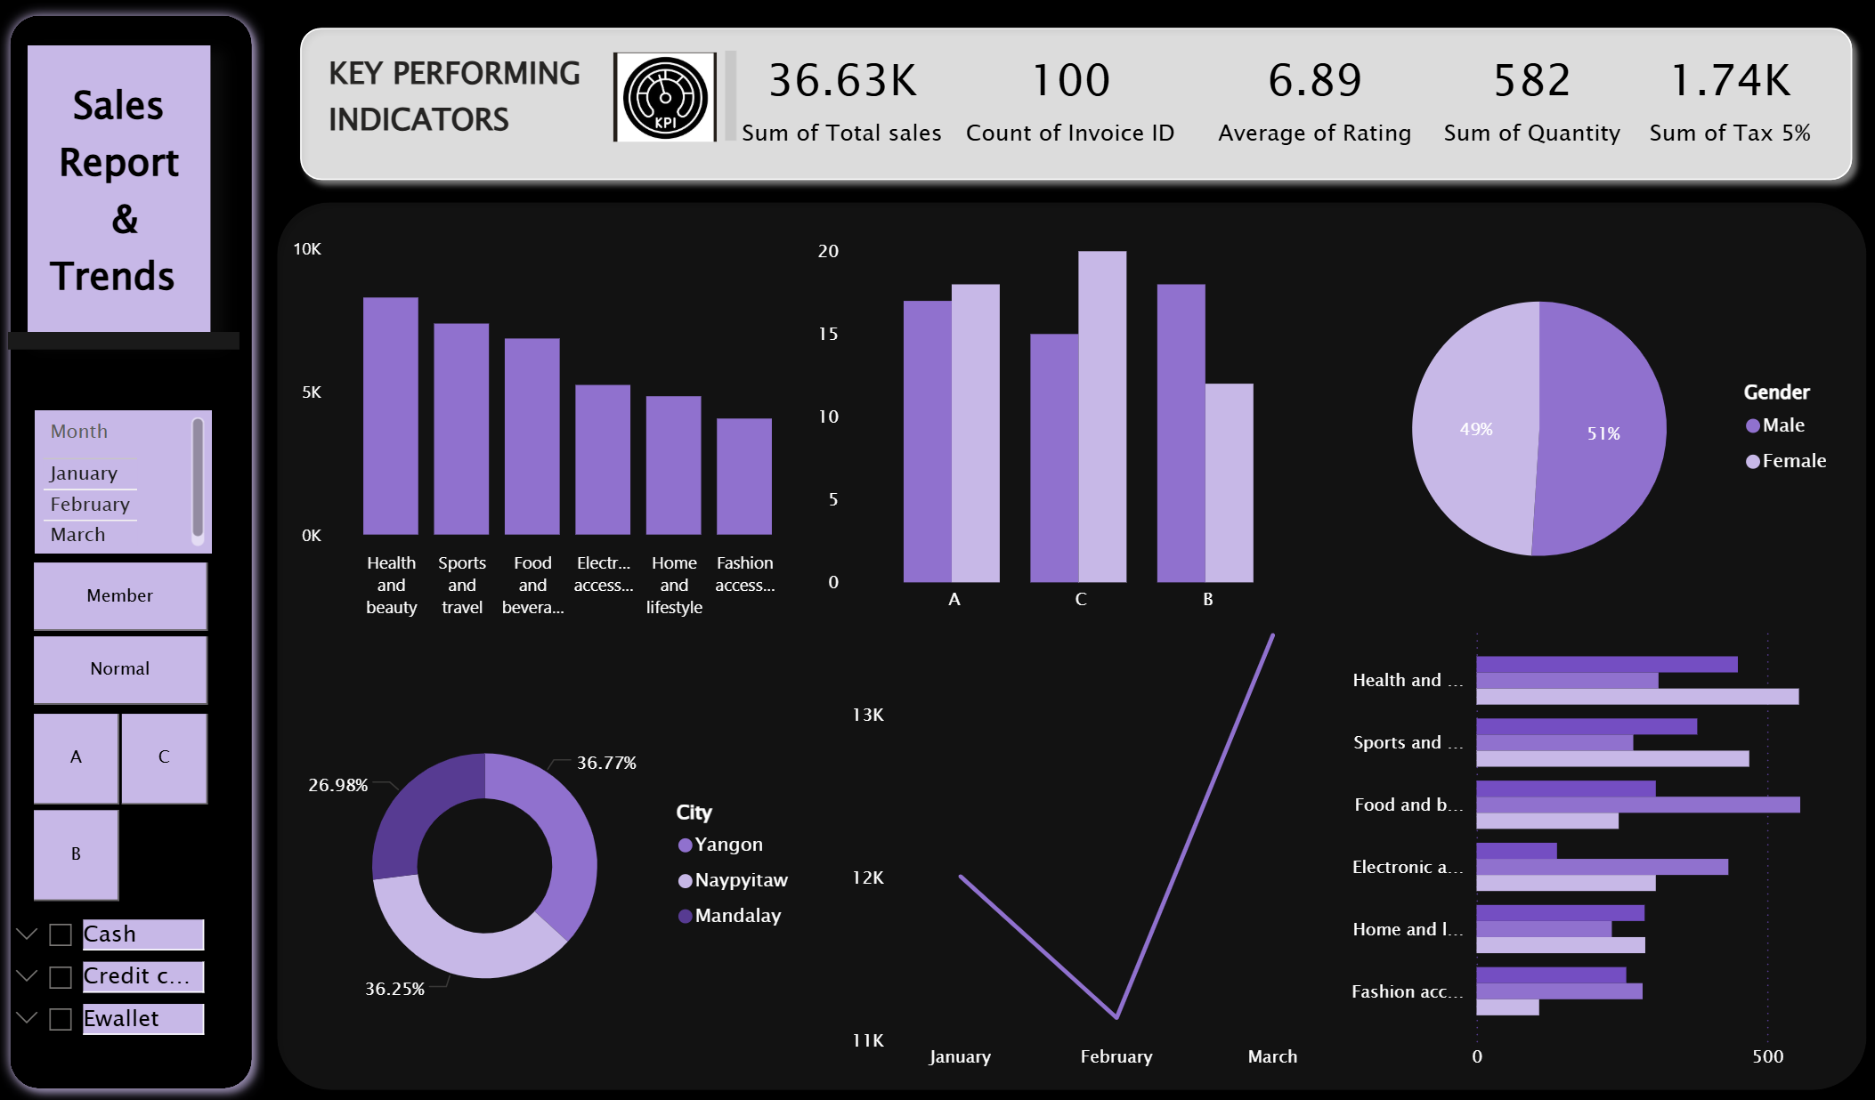

Slide 8

CUSTOMER DEMOGRAPHICS
CUSTOMER INSIGHTS
Health & Beauty, Sports & Travel, and Food & Beverages are the top-performing product categories, driving the majority of sales revenue.
Branch C (Naypyitaw) recorded the highest sales.
E-wallet payments are the most preferred payment method.
Normal customers generate more total revenue than Members.
Sales performance peaked in March after a February dip
The average customer rating of 6.89 indicates moderate satisfaction, highlighting opportunities for service quality improvements.
Electronic Accessories and Fashion Accessories significantly underperformed.
Understanding Our Audience

Slide 9
Reaching New Heights
MARKET EXPANSION RECOMMENDATION
Increase stock and promotional activities for Health & Beauty, Sports & Travel, and Food & Beverages to capitalize on high demand.
Investigate and address underperformance in Electronic Accessories, Fashion Accessories, and Home & Lifestyle through pricing reviews or product repositioning.
Study and replicate Branch C's successful strategies across Branch A and Branch B to improve overall sales performance.
Strengthen membership programs with exclusive benefits and discounts to convert more normal customers into loyal members.
Introduce E-wallet payment incentives such as cashback or loyalty points to encourage digital adoption and reduce transaction costs.
Improve customer experience and service quality to raise the average rating above 6.89, particularly in lower-rated branches.
Implement strategic bundling of underperforming products with top sellers to boost sales of weaker categories.
REPORT

Slide 10
Trip tech
CONCLUSION
OUR STRENGHT
From the analysis, we can see products, cities, and branches bring in the most money. We also learned how different types of customers buy and pay for items. Looking at monthly sales helped us see when business is high or low. Comparing products across cities showed that people in different places prefer and pay for things differently. Customer ratings gave us an idea of how satisfied they are. We also saw that the type of customer affects how each branch performs. Overall, these findings can help the business make better decisions, improve sales, and give customers a better experience.
S

Slide 11
Trip tech
OCTOBER 2025
Thank You
For Attention
COMPANY PERFORMANCE OVERVIEW PRESENTATION

